Slide 1
Practices for Remote Repositories

Slide 2
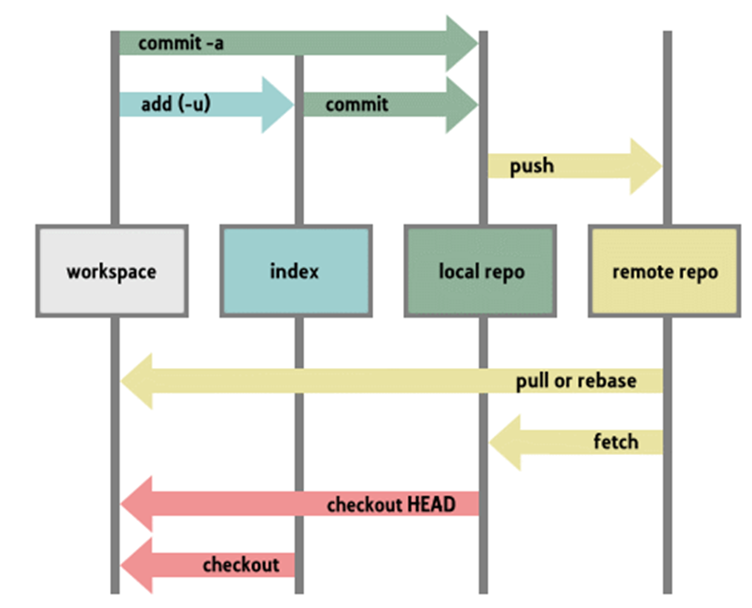
Local and Remote Repositories

Slide 3
Git Origin & Remote Repositories
For a cloned repository the Origin is the remote repository that the project was cloned from. This Url is then stored in the git config file and can then be referenced as “origin” for future commands.
To see which remote server you have configured as the origin:
git remote –v
To add a remote repository to an un-cloned repository.
git remote add origin <remote url>

Slide 4
Updating your Git repository - Push
The default branch name on a local and remote repository is called Master.
After staging your files and then committing them to the branch of the repository that you are working on you might then want to update the remote repository that the project was cloned from. The push command will send changes from the current HEAD location to a remote repository.
git push origin master
This will push the files to the master branch of your repository on the cloud. You could target any branch in the remote repository not just the master branch

Slide 5
Git Pull
Someone in your team has updated their code and now you want to try it out!
The git pull command changes only files/code/lines that have been changed. It is very efficient at finding the difference and only updating the difference to decrease the amount of data being sent.
git pull –all
Git pull, will try to fetch and merge remote changes.
To merge from another branch into your active branch you need to use:
git merge <branch>

Slide 6
Git Merging
Merging allows us to bring two branches back to a common source.
When merging, git will try to auto-merge any changes.
This is not always possible as the same parts of file may have been edited in each branch and this will result in conflicts.
You then have to merge those conflicts manually
git status will let you see which files have been unmerged at any point after a merge conflict.

Slide 7
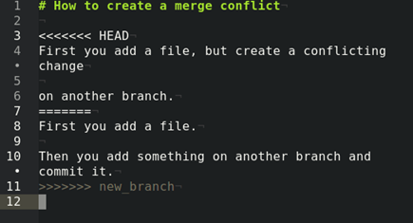
Git Merging
In git there can be coding conflicts called Merge Conflicts.
These occur when another person in your team has pushed code on the same file you have edited.
When this happens you will not be able to commit and push your code until you solve the merge conflict.
If there is a merge conflict your code should look like this in your editor:

Slide 8
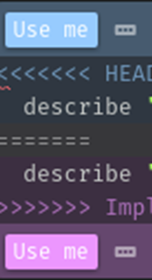
Git Merging
To fix this either chose which version to keep (HEAD or BRANCH) or modify the code to include what is required then remove any unwanted code.
The different versions will be indicated by:
<<<<<<< HEAD
Some code version 1
=======
Some code version 2
>>>>>>> new_branch
If your editor helps with merge conflicts press the “use this”/ “
use me” button to solve your merge conflict issue.

Slide 9
Multi-user push back to origin - Scenario
User A and User B clone a repository they have read/write access to.
(All public repositories on GitHub are READ accessible but you will need permission as a contributor to write to them.)
User A changes a file adds it to staging and then commits a change. User B changes the same file , stages it and commits a change.
User A pushes their commits to the origin master and is successful
User B pushes their commits to origin master but fails because there is a conflict in the content of the file.
User B must Pull down the latest code from the origin master. Any files with conflicts will now be marked to be checked and updated. User B then adds the updated file and continues the rebase.
See code command on the next slide.

Slide 10
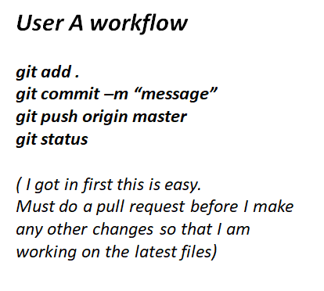
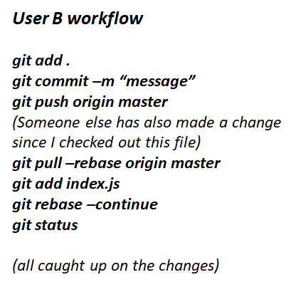
Multi-user push back to origin: workflow commands

Slide 11
Forking
A fork is a copy of a repository. Forking a repository allows you to freely experiment with changes without affecting the original project.
Most commonly, forks are used to either propose changes to someone else's project or to use someone else's project as a starting point for your own idea.
A great example of using forks to propose changes is for bug fixes. Rather than logging an issue for a bug you've found, you can:
Fork the repository.
Make the fix.
Submit a pull request to the project owner.

Slide 12
Pull Requests
Create a pull request to propose and collaborate on changes to a repository. These changes are proposed in a branch, which ensures that the master branch only contains finished and approved work.
Pull requests can only be opened if there are differences between your branch and the upstream branch. You can specify which branch you'd like to merge your changes into when you create your pull request.
At GitHub goto the branch you would like the master branch to pull, and to the right of the menu press the New pull request button.
Create a description for the pull request then
press the Create pull request button

Slide 13
Further information
For more information about git and how to use it checkout
https://guides.github.com/activities/hello-world/
for a short guide on using GIT with GitHub
Some other related Git information
https://www.atlassian.com/git/tutorials/setting-up-a-repository
https://www.atlassian.com/git/tutorials/syncing

